Slide 1
Wireless Security

Slide 2




The Current Internet: Connectivity and Processing
Cable
Modem
Access
Networks
Premises-
based
LAN
Transit Net
LAN
Private
Peering
LAN
Premises-
based
Core Networks
WLAN
Transit Net
WLAN
WLAN
NAP
Analog
Public
Peering
Transit Net
Operator-
based
RAS
DSLAM
Regional
Wireline
Regional
Cell
H.323
Data
Cell
Data
H.323
Cell
PSTN
Voice
Voice
Notes:
The ISP likely has banks of many modems multiplexed onto a high capacity telephone cable that transports a large number of phone calls simultaneously (such as a T1, E1, ISDN PRI, etc.). This requires a concentrator or "remote access server" (RAS).

Slide 3
How can it affect cell phones?
Cabir worm can infect a cell phone
  Infect phones running Symbian OS
  Started in Philippines at the end of 2004, surfaced in Asia, Latin America, Europe, and later in US
  Posing as a security management utility
  Once infected, propagate itself to other phones via Bluetooth wireless connections
  Symbian officials said security was a high priority of the latest software, Symbian OS Version 9.
With ubiquitous Internet connections, more severe viruses/worms for mobile devices have appeared and will continue to strive …
Notes:
Symbian OS: the mobile OS provider
A few more recent ones in 2005 and 2006 etc.: http://www.cse.psu.edu/~enck/cse597a-s09/slides/cse597a-virus.pdf

Slide 4
Outlines
802.11 Basics
Security in 802.11b: WEP
WPA and WPA2

Slide 5
IEEE 802.11 Wireless LAN
802.11b
  up to 11 Mbps
802.11a
  up to 54 Mbps
802.11g
  up to 54 Mbps
802.11n
  up to 150 ~ 600 Mbps
All have base-station and ad-hoc network versions

Slide 6
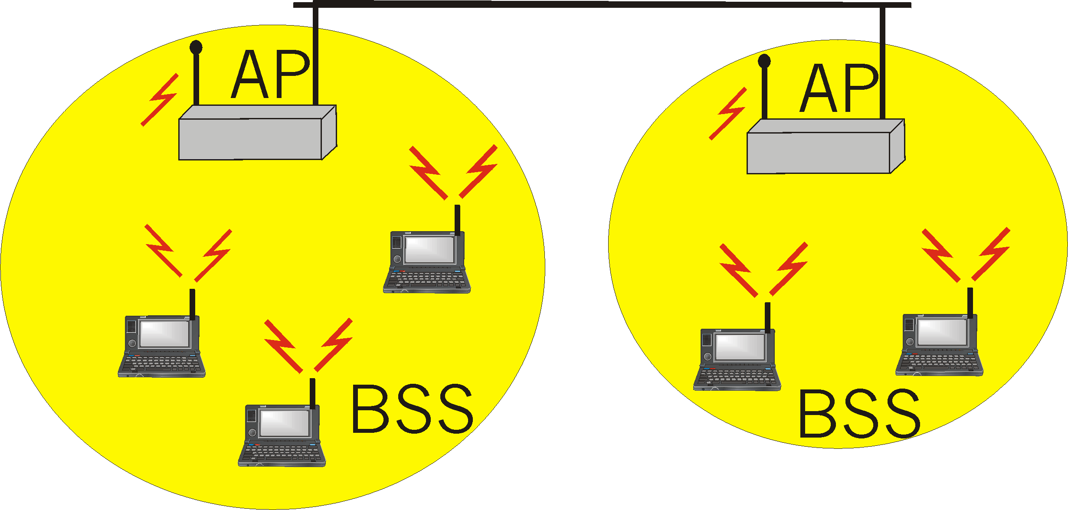
Base station approch
Wireless host communicates with a base station
  base station = access point (AP)
Basic Service Set (BSS) (a.k.a. “cell”) contains:
  wireless hosts
  access point (AP): base station
BSS’s combined to form distribution system (DS)

Slide 7
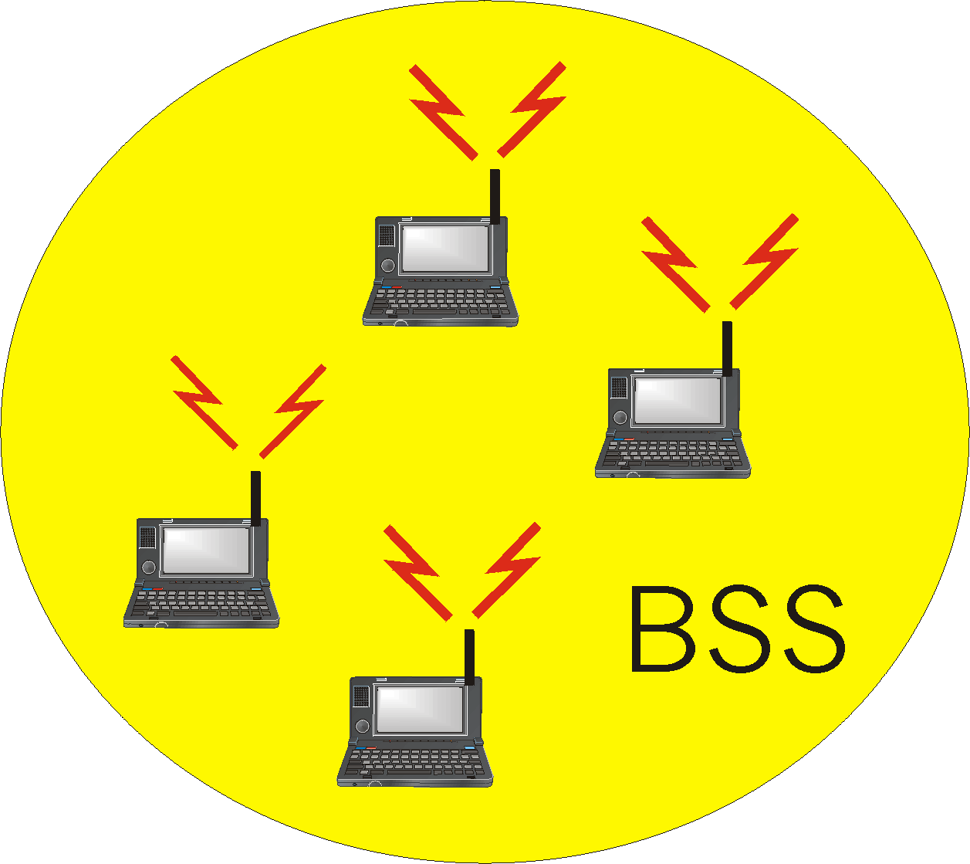
Ad Hoc Network approach
No AP (i.e., base station)
wireless hosts communicate with each other
  to get packet from wireless host A to B may need to route through wireless hosts X,Y,Z
Applications:
  “laptop” meeting in conference room, car
  interconnection of “personal” devices
  battlefield

Slide 8
Outlines
802.11 Basics
Security in 802.11b
WEP
WPA and WPA2

Slide 9
802.11b: Built in Security Features
Service Set Identifier (SSID)
Differentiates one access point from another
SSID is cast in ‘beacon frames’ every few seconds.
Beacon frames are in plain text!

Slide 10
Associating with the AP
Access points have two ways of initiating communication with a client
Shared Key or Open System authentication
Open System: need to supply the correct SSID
  Allow anyone to start a conversation with the AP
Shared Key is supposed to add an extra layer of security by requiring authentication info as soon as one associates
Notes:
Open System Authentication
Open system authentication simply consists of two communications. The first is an authentication request by the client that contains the station ID (typically the MAC address). This is followed by an authentication response from the AP/router containing a success or failure message. An example of when a failure may occur is if the client's MAC address is explicitly excluded in the AP/router configuration.
Shared Key Authentication
Shared key authentication relies on the fact that both stations taking part in the authentication process have the same "shared" key or passphrase. The shared key is manually set on both the client station and the AP/router. Three types of shared key authentication are available today for home or small office WLAN environments.

Slide 11
How Shared Key Auth. works
Client begins by sending an association request to the AP
AP responds with a challenge text (unencrypted)
Client, using the proper WEP key, encrypts text and sends it back to the AP
If properly encrypted, AP allows communication with the client

Slide 12
Wired Equivalent Protocol (WEP)
Primary built security for 802.11 protocol
Uses 40bit RC4 encryption
Intended to make wireless as secure as a wired network
Unfortunately, since ratification of the 802.11 standard, RC4 has been proven insecure, leaving the 802.11 protocol wide open for attack

Slide 13
Wi-Fi Protected Access (WPA)
Flaws in WEP known since January 2001 - flaws include weak encryption (keys no longer than 40 bits), static encryption keys, lack of key distribution method.
In April 2003, the Wi-Fi Alliance introduced an interoperable security protocol known as WiFi Protected Access (WPA).
WPA was designed to be a replacement for WEP networks without requiring hardware replacements.
WPA provides stronger data encryption (weak in WEP) and user authentication (largely missing in WEP).

Slide 14
WPA Security Enhancements
WPA includes Temporal Key Integrity Protocol (TKIP) and 802.1x mechanisms.
The combination of these two mechanisms provides dynamic key encryption and mutual authentication
TKIP adds the following strengths to WEP:
  Per-packet key construction and distribution:
  WPA automatically generates a new unique encryption key periodically for each client. This avoids the same key staying in use for weeks or months as they do with WEP.
  Message integrity code: guard against forgery attacks.
  48-bit initialization vectors, use one-way hash function instead of XOR

Slide 15
WPA2
In July 2004, the IEEE approved the full IEEE 802.11i specification, which was quickly followed by a new interoperability testing certification from the WiFi Alliance known as WPA2.
Strong encryption and authentication for infrastructure and ad-hoc networks (WPA1 is limited to infrastructure networks)
  Use AES instead of RC4 for encryption
WPA2 certification has become mandatory for all new equipment certified by the Wi-Fi Alliance, ensuring that any reasonably modern hardware will support both WPA1 and WPA2.
Notes:
RC4 is stream cipher. AES block cipher has better performance and security.
Support for the CCMP (Counter Mode with Cipher Block Chaining Message Authentication Code Protocol) encryption mechanism based on the AES as an alternative to the TKIP protocol
AES is the equivalent of the RC4 algorithm used by WPA.
CCMP is the equivalent of TKIP in WPA. Changing even one bit in a message produces a totally different result.

Slide 16
Project Part III Presentation
Summary of the problem statement
Related work
Your technical solution and comparison w/ existing work
Property analysis of your solution
  the cost/risk analysis: Both the system purchase and maintenance cost. Compared with existing work.
  feasibility analysis: Is it easy to be adopted by the IT and other users of your company/institute? Is it incrementally deployable or require complete tear-down?
  business/legal consequence.
Every team will have a time limit of 20 minutes for presentation which will be strictly enforced (15 mins lecturing, 3 mins Q&A, & 2 mins switch time).

Slide 17
Quiz on Tech Integration
Select technology from the following list to satisfy the PCI compliance requirements
  Basically use the Cisco table in the pdf slides.

Slide 18
Backup Slides

Slide 19
Assessing the Network
Using Netstumbler, the attacker locates a strong signal on the target WLAN
WLAN has no broadcasted SSID
Multiple access points
Many active users
Open authentication method
WLAN is encrypted with 40bit WEP

Slide 20
Cracking the WEP key
Attacker sets NIC drivers to Monitor Mode
Begins capturing packets with Airsnort
Airsnort quickly determines the SSID
Sessions can be saved in Airsnort, and continued at a later date so you don’t have to stay in one place for hours
A few 1.5 hour sessions yield the encryption key
Once the WEP key is cracked and his NIC is configured appropriately, the attacker is assigned an IP, and can access the WLAN

Slide 21
Summary of MAC protocols
What do you do with a shared media?
  Channel Partitioning, by time, frequency or code
    Time Division,Code Division, Frequency Division
  Random partitioning (dynamic),
    ALOHA, CSMA, CSMA/CD
    carrier sensing: easy in some technologies (wire), hard in others (wireless)
    CSMA/CD used in Ethernet

Slide 22
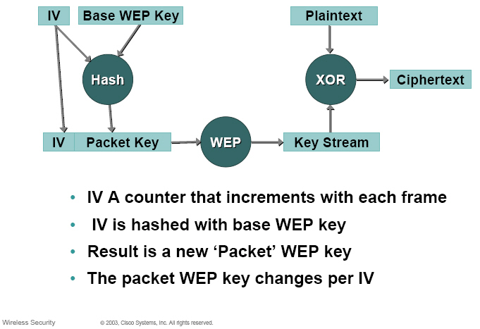
Solution

Slide 23
Case study of a non-trivial attack
Target Network: a large, very active university based WLAN
Tools used against network:
  Laptop running Red Hat Linux v.7.3,
  Orinoco chipset based 802.11b NIC card
  Patched Orinoco drivers
  Netstumbler
    Netstumbler can not only monitor all active networks in the area, but it also integrates with a GPS to map AP’s
  Airsnort
    Passively listen to the traffic
NIC drivers MUST be patched to allow Monitor mode (listen to raw 802.11b packets)

